Slide 1
Fair Housing Foundations

Slide 2

Jonathan Duy
Single Family Relations Manager
Ohio Housing Finance Agency
jduy@ohiohome.org
www.ohiohome.org

Slide 3
Your certificates will be emailed by Tuesday.
Copy of today's presentation: Ohiohome.org/RP
You have to be present 90% of the class to receive CE credit.

Slide 4
Webinar Classes
  You have to be watching on a computer/tablet or Microsoft Teams app to receive credit. If you are listening via phone audio, you will not receive credit.
  You have to be using your own individual device (two people can’t be sharing a computer).

Slide 5

History of Fair Housing and Civil Rights
“We hold these truths to be self-evident, that all men are created equal, that they are endowed by their Creator with certain unalienable rights, that among these are life, liberty and the pursuit of happiness.”

Slide 6
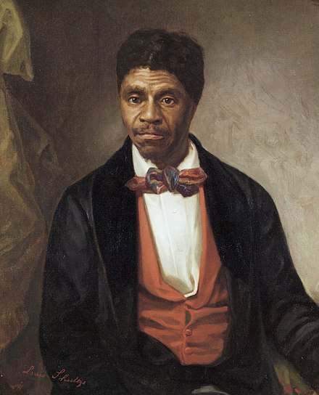
1790- Naturalization Act-Limited naturalization to free white persons.
1857-Dred Scott v. Sanford-Declared that slaves were not citizens of the United States and could not sue in Federal courts.

Slide 7

1857-Dred Scott v. Sanford

Slide 8

1863-Emancipation Proclamation
Presidential proclamation that freed the slaves.

Slide 9

1865-13th Amendment –Abolished slavery.
1866-Civil Rights Act-all persons born in the United States were declared to be citizens of the United States.

Slide 10
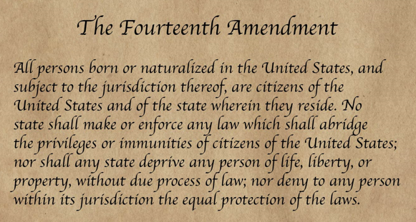
1868-14th Amendment- All persons born or naturalized in the United States are granted citizenship. The 14th amendment was passed to ensure the Civil Rights Act of 1866 was upheld.

Slide 11

1882-Chinese exclusion act

Slide 12
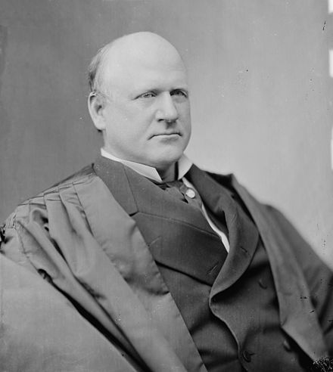

1896 Plessy v. Ferguson- “Separate but equal”-legal basis for segregation in the United States.
Dissenting view of John Marshal Harlan:

Slide 13
“It is therefore to be regretted that this high tribunal, the final expositor of the fundamental law of the land, has reached the conclusion that it is competent for a state to regulate the enjoyment by citizens of their civil rights solely upon the basis of race.
In my opinion, the judgment this day rendered will, in time, prove to be quite as pernicious as the decision made by this tribunal in the Dred Scott Case.”

Slide 14
1896 Plessy v. Ferguson

Slide 15
1917 Buchannan V. Warley- Racial zoning (government zoning) of minorities is a violation of the 14th amendment.
1920-19th Amendment- Women’s right to vote.
1924-Indian Citizenship Act- Granted citizenship to all Native Americans.

Slide 16

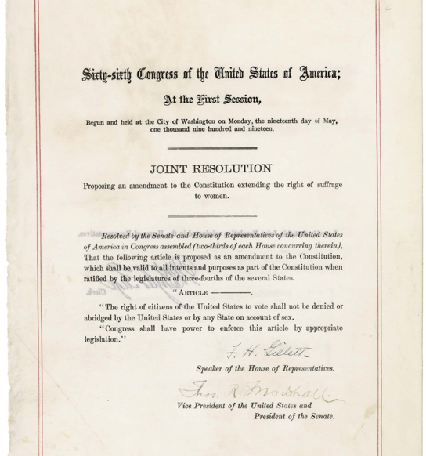

Slide 17


1941- Tuskegee Airmen

Slide 18


1942 Japanese internment camps

Slide 19

1942 Japanese internment camps

Slide 20


Slide 21

Green’s Travel Book

Slide 22
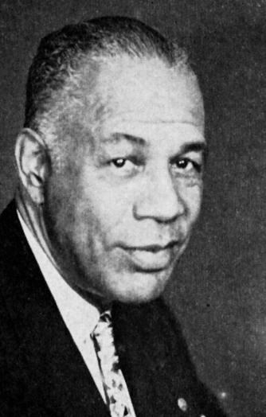
Green’s Travel Book
Created by New York City mailman Victor Hugo Green from 1936 to 1966 during the era of Jim Crow laws.
Intent of the book was to create safe places for people to stop such as gas stations, restaurants, and hotels.

Slide 23


Slide 24
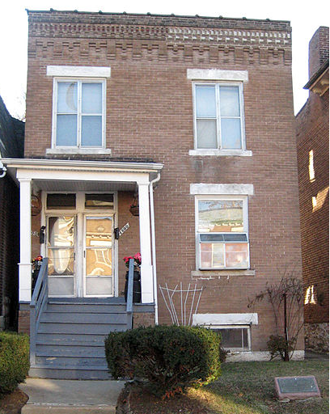
1948
Shelley v. Kraemer

Slide 25
1954-Brown v. Board of Education

Slide 26

Emmett Till was murdered in 1955 in Mississippi.
In 1956, the murderers sold their story to “Look Magazine” for $4,000 detailing how they murdered him.

Slide 27


1955-Rosa Parks

Slide 28


1957-Little Rock 9

Slide 29

1960-Sit-ins

Slide 30
1960-Sit-ins

Slide 31

1961-Freedom Rides

Slide 32

1961-Freedom rides

Slide 33


1963-16th Street church bombing

Slide 34
1963-16th Street church bombing

Slide 35


Slide 36
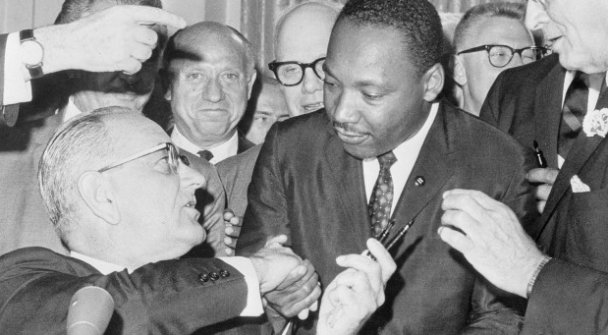
President Lyndon Johnson and Dr. Martin Luther King Jr. at the signing of the 1964 Civil Rights Act.

Slide 37

1965-Voters rights-Selma, Alabama

Slide 38

John lewis

Slide 39

1965-Voting Rights Act-applied a nationwide prohibition against the denial or abridgment of the right to vote based on race.

Slide 40

Memphis Sanitation Worker Strike-1968

Slide 41

Assassination of MLK-1968

Slide 42
Fair Housing Act-1968
Race
Color
National Origin
Religion
Sex
Familial Status
Disability
Prohibits discrimination in the sale, rental, and financing of dwellings, and in other housing-related transactions.

Slide 43


Two additional protected classes in ohio
Military Status
Ancestry

Slide 44

Equal Credit Opportunity Act 1974
Prohibits credit discrimination based on race, color, religion, national origin, sex, marital status, and age.

Slide 45

1982-Havens v. Coleman-gave fair housing testers the right under the Federal Fair Housing Law to sue individuals practicing housing discrimination.

Slide 46

1988 Amendment Act-added familial status and disability.

Slide 47

1990-Americans with disabilities act

Slide 48
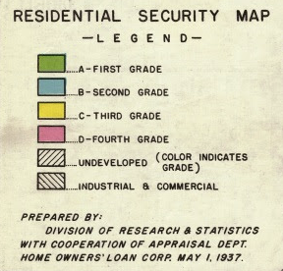
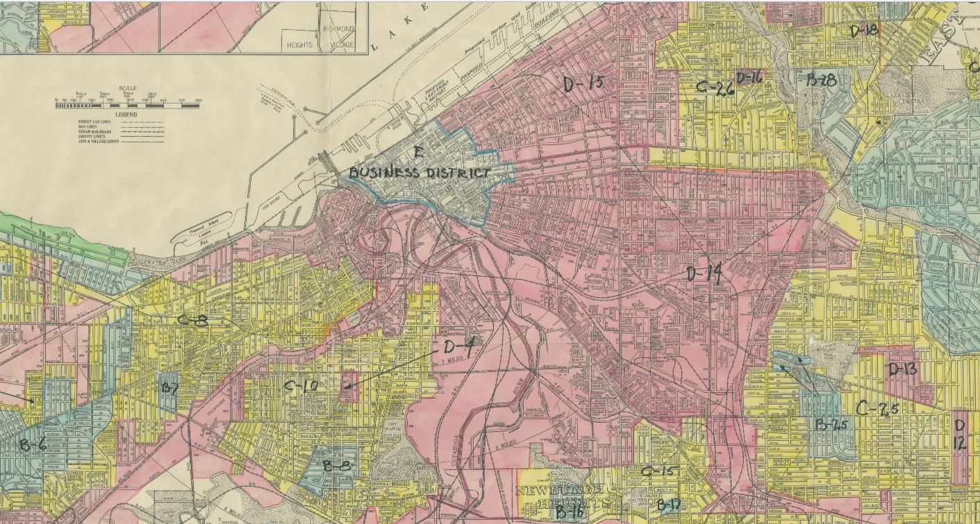
1937 Redlining map

Slide 49
Redlining 1934-1968
The Federal Housing Administration refused to insure loans to black communities or to white communities that were close in proximity to black communities.
Did not become illegal until the Fair Housing Act of 1968. Prevented most African-Americans from purchasing homes.

Slide 50

Redlining-City National Bank-2023

Slide 51

Case Studies

Slide 52


Slide 53


Slide 54
2022-Fair Housing Testing Settlement
Keller Williams Greater Nassau (KWGN),
Keller Williams Realty Elite (KWRE), and
Laffey Real Estate (LRE)
Required to pay $115,000 settlement and conduct fair housing trainings for their offices.

Slide 55
United States v. Rupp, et al. (E.D. Mo.), 2021
Defendants used a lease and application that stated that “no children” were allowed; rented an apartment to the complainants, with one minor child at the time, “on a trial basis” in light of their “no children” lease condition.
Terminated the complainants’ lease after the landlord learned they had a second child.
$74,400 verdict

Slide 56

Diving into the details...
In the Sale and Rental of Housing: No one may take any of the following actions based on race, color, national origin, religion, sex, familial status, handicap, ancestry, or military status.

Slide 57
Examples
Refuse to rent or sell housing.
Refuse to negotiate for housing.
Make housing unavailable.
Deny a dwelling.
Set different terms, conditions or privileges for sale or rental of a dwelling.

Slide 58
Examples
Provide different housing services or facilities.
Falsely deny that housing is available for inspection, sale, or rental.
For profit, persuade owners to sell or rent (blockbusting).
Deny anyone access to or membership in a facility or service (such as an MLS) related to the sale or rental of housing.

Slide 59

Pave initiative to advance property appraisal and valuation equity

Slide 60
Bailey v. Santander bank (2023)
In December 2023, a mixed-race Connecticut couple settled an appraisal discrimination lawsuit with Santander Bank under undisclosed terms. The plaintiffs had alleged violations of the Fair Housing Act after receiving a low valuation on their home.
In February 2021, the bank’s appraiser appraised the 7,000 square foot, seven-bedroom home at $780,000, and the bank denied the plaintiff’s refinancing application because of the low valuation.

Slide 61
Bailey v. Santander bank (2023)
After the plaintiffs removed family photos and artwork, the husband, who is White, greeted the second appraiser. The second appraisal came in at $1.2 million, which was $420,000 more and nearly 54 percent higher than the first appraisal.

Slide 62
Low appraisal valuation

Slide 63
Low appraisal valuation

Slide 64
Low appraisal valuation

Slide 65
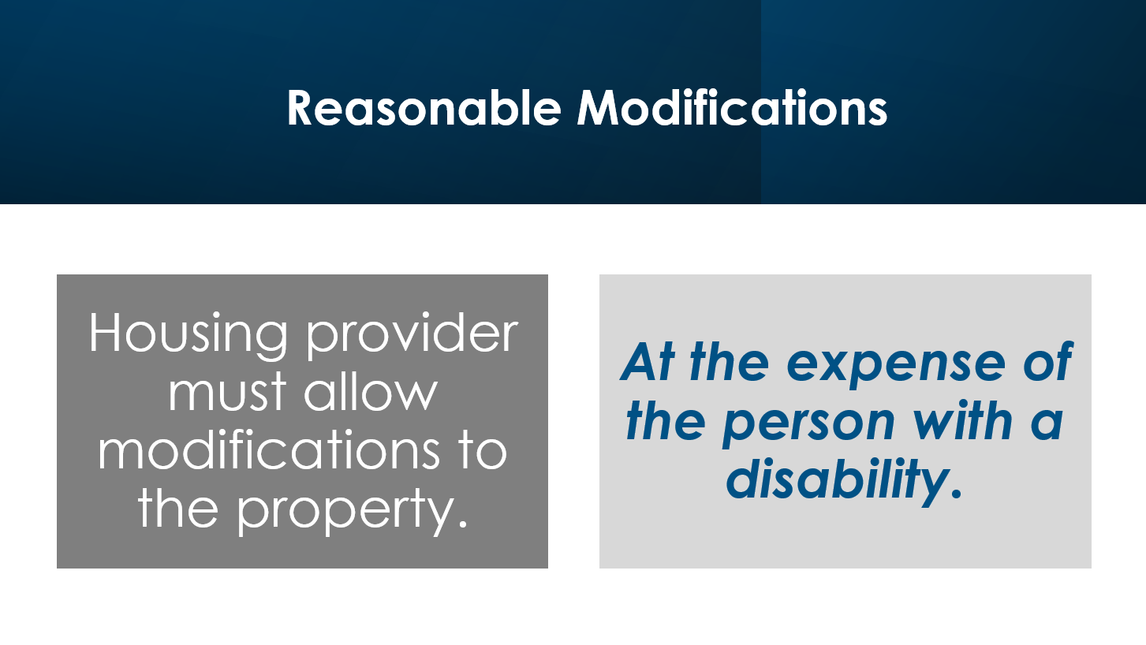

Slide 66

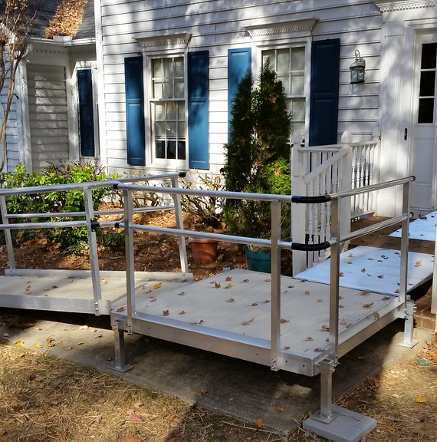

Slide 67
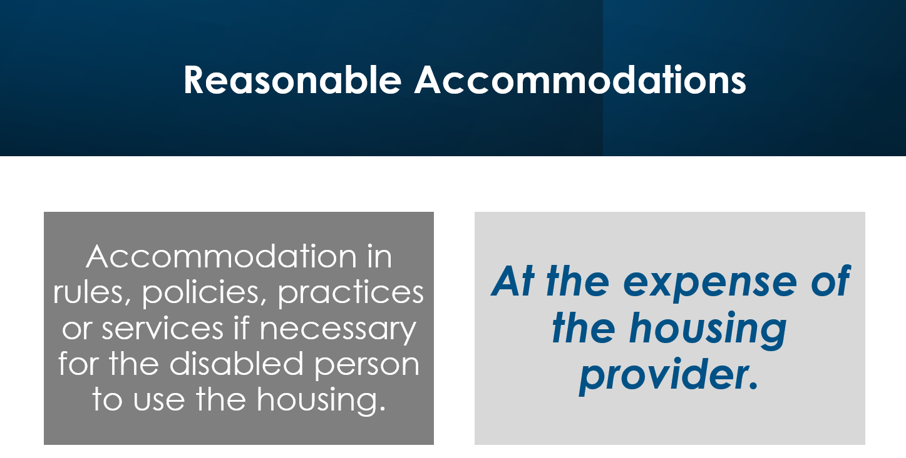

Slide 68


Slide 69
What is a service/support/companion animal?
Under the Fair Housing Act, a service/support/companion animal can be for a physical or mental disability and the animal does not have to have special training or perform a specific task.
Under Fair Housing, there is no difference between a physical or mental/emotional disability.
FHEO-2020-01

Slide 70
Readily Apparent Disability
If a person’s disability is obvious, or otherwise known to the provider, and if the need for the requested accommodation is also readily apparent or known,
Then the provider may not request any additional information about the requester's disability or the disability-related need for the accommodation.
FHEO-2020-01

Slide 71

Readily Apparent Disability
Guiding an individual who is blind or has low vision.
Pulling a wheelchair.
Providing assistance with stability or balance to an individual with an observable mobility disability.
FHEO-2020-01

Slide 72
Non-observable disability
A provider is entitled to obtain information that is necessary to evaluate if a requested reasonable accommodation may be necessary because of a disability.
The person with a disability could provide the following as proof of a disability related need or a service animal:
FHEO-2020-01

Slide 73
Document requests
Information confirming disability from a health care professional – e.g., physician, optometrist, psychiatrist, psychologist, physician’s assistant, nurse practitioner, or nurse.
A determination of disability from a federal, state, or local government agency.
Receipt of disability benefits or services (Social Security Disability Income (SSDI)).
FHEO-2020-01

Slide 74
Document requests
Medicare or Supplemental Security Income (SSI) for a person under age 65, veterans’ disability benefits, services from a vocational rehabilitation agency, or disability benefits or services from another federal, state, or local agency.
Eligibility for housing assistance or a housing voucher received because of disability.
You can’t ask about their private medical diagnosis or medical information.
FHEO-2020-01

Slide 75
Documents from the internet
Some websites sell certificates, registrations, and licensing documents for assistance animals to anyone who answers certain questions or participates in a short interview and pays a fee.
In HUD’s experience, such documentation from the internet is not, by itself, sufficient to reliably establish that an individual has a non-observable disability or disability-related need for an assistance animal.
FHEO-2020-01

Slide 76


What animals are allowed?
If the animal is a dog, cat, small bird, rabbit, hamster, gerbil, other rodent, fish, turtle, or other small, domesticated animal that is traditionally kept in the home for pleasure rather than for commercial purposes, then the reasonable accommodation should be granted because the requestor has provided information confirming that there is a disability related need for the animal.
FHEO-2020-01

Slide 77
What animals are allowed?
Unique Animals:
If the individual is requesting to keep a unique type of animal that is not commonly kept in households as described above, then the requestor has the substantial burden of demonstrating a disability-related therapeutic need for the specific animal or the specific type of animal.
Please note this is not an exhaustive list and other animals not listed in the previous slides, might be allowable.
FHEO-2020-01

Slide 78
Additional Items
A housing provider may not charge a deposit, fee, or surcharge for an assistance animal.
A housing provider, however, may charge a tenant for damage an assistance animal causes if it is the provider’s usual practice to charge for damage caused by tenants (or deduct it from the standard security deposits imposed on all tenants).
FHEO-2020-01

Slide 79
Additional Items
Pet rules do not apply to service animals and support animals.
Housing providers may not limit the breed or size of a dog used as a service animal or support animal just because of the size or breed but can, as noted, limit based on specific issues with the animal’s conduct because it poses a direct threat or a fundamental alteration.
FHEO-2020-01

Slide 80


Slide 81
Senior exemption
The HUD Secretary has determined that it is specifically designed for and occupied by elderly persons under a Federal, State or local government program or
It is occupied solely by persons who are 62 or older or
It houses at least one person who is 55 or older in at least 80 percent of the occupied units, and adheres to a policy that demonstrates an intent to house persons who are 55 or older.

Slide 82
Case Studies

Slide 83
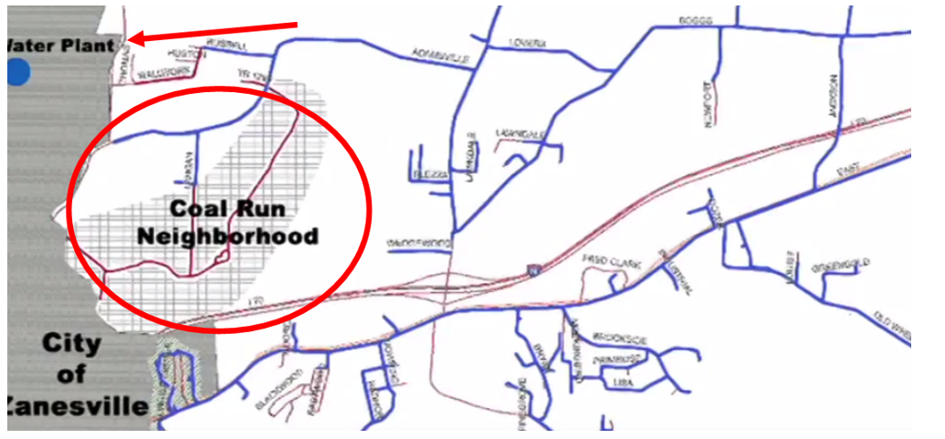
Kennedy v. Zanesville (2008) (Ohio) $10.8 Million

Slide 84

Use of words, phrases, symbols, and visual aids can’t convey overt or implicit discrimination.

Slide 85

Fair housing advertising
Ohio law requires every broker’s office to display the fair housing poster provided by the Ohio Real Estate Commission with the required language (Ohio Revised Code section 4735.16).
Ohio law (O.R.C. 4735.55 and Ohio Administrative Code 1301:5-6-05) states that fair housing language must be included in all agency agreements if the property in question is covered by the fair housing laws.
Should use Equal Housing Opportunity Statement, Slogan, or Logo.
Source: Ohio Department of Commerce and HUD

Slide 86

Focus on the attributes of the home, not on the attributes of potential buyers.
Updated roof
New carpeting
Large backyard
Large living room

Slide 87
United states v. meta (2022)
The complaint, which was filed on June 21, 2022, alleged that Meta’s housing advertising system discriminated against Facebook users based on the federally protected classes.
Specifically, the complaint alleged, among other things, that Meta uses algorithms in determining which Facebook users receive housing ads and that those algorithms rely, in part, on characteristics protected under the FHA.

Slide 88
Exemptions from fair housing laws
Housing operated by organizations and private clubs that limit occupancy to members (ORC§ 4112.024, A &B).
Ohio Fair Housing Laws are more stringent than Federal Fair Housing Laws.
There are no exemptions for Real Estate Agents.
Source: Ohio Revised Code: 4112.024

Slide 89
Filing a complaint
Ohio Civil Rights Commission
civ.ohio.gov

Slide 90



Slide 91
No one may take any of the following actions based on race, color, national origin, religion, sex, familial status or handicap (disability):
Refuse to make a mortgage loan.
Refuse to provide information regarding loans.

Slide 92
Impose different terms or conditions on a loan, such as different interest rates, points, or fees. (One of the most common ways people are discriminated against in mortgage lending.)
Discriminate in appraising property.

Slide 93

Refuse to purchase a loan. (secondary mortgage market)
Set different terms or conditions for purchasing a loan.

Slide 94
OHFA Homeownership Programs

Slide 95


Slide 96
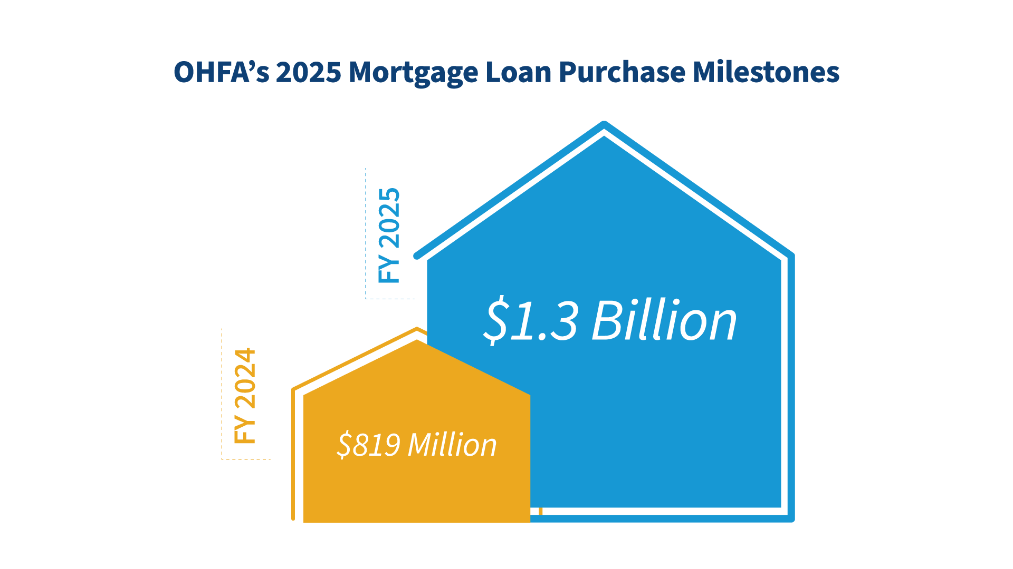

Slide 97
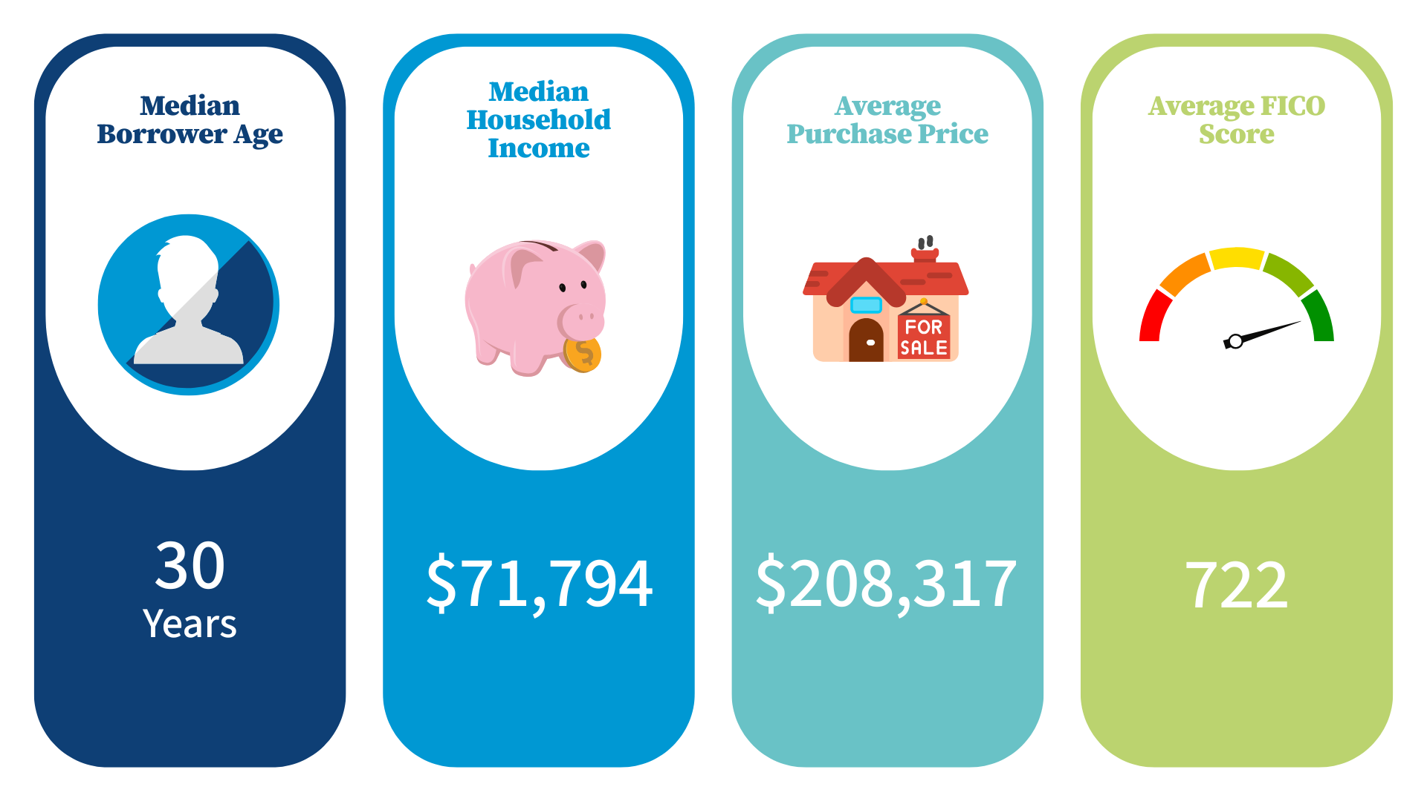

Slide 98


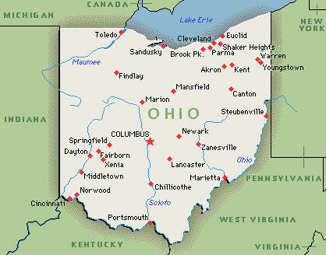
Important Items to Know about OHFA
OHFA homeownership programs can be used anywhere in the State of Ohio.
Not all lenders (Banks or Mortgage Companies) are OHFA participating lenders. Participating lenders can be found at: www.myohiohome.org

Slide 99
Homebuyer contacts an OHFA approved lender for an eligibility review.
1
Homebuyer chooses the loan program that best fits their needs.
2
Homebuyer goes through normal home buying process with a real estate agent.
3

Slide 100
OHFA Participates in All of the Major Loan Types
Conventional 3%
FHA 3.5%
VA 0%
USDA 0%

Slide 101


Slide 102


Slide 103
Main Eligibility Requirements
Income Limits
www.myohiohome.org
Minimum Credit Score
FHA: 650
Conventional, USDA, VA: 640

Slide 104

First-Time Homebuyer
Someone who has not had ownership interest in a primary residence in the last three years.
Anyone buying in a Target Area- A target area is an economically distressed area.
Honorably Discharged Veteran- Regardless if they currently own a home or have owned a home in the past three years.

Slide 105


Slide 106

OHFA Down Payment Assistance
You can use the assistance to pay for the down payment, closing costs, or other prepaid expenses.
Your interest rate will be slightly higher than OHFA’s standard mortgage rates.
You can’t sell the house for the first 7 years, otherwise you have to pay back the entire down payment assistance. (Homebuyer can refinance using OHFA’s Refinance Program.)

Slide 107
OHFA Down Payment Assistance Offered
Conventional
3%
FHA, VA, USDA
3.5%

Slide 108
Conventional Loan (3% DP Requirement)
Purchase Price $200,000
3% Down Payment Assistance $6,000
Subtract the Down Payment 3% Down Payment -$6,000
_______________________________________________
Approximate out-of-pocket funds: $4,000-$6,000
This is based on approximate closing costs of $6,000. Closing costs vary for each lender.
Seller can contribute money towards buyers closing costs.

Slide 109
Wealth and Homeownership Example-Columbus Region
Approximate median price appreciation between 2020 and 2024 in the Columbus region (Franklin County) was 41.25%. For informational purposes only.

Slide 110


Slide 111
Ohio Heroes
Full-time employees in the following professions receive a slightly lower interest rate:
Veteran, active-duty military or member of reserve components (includes a surviving spouse)
Police officer, firefighter, volunteer firefighter, EMT, paramedic

Slide 112
Ohio Heroes
Physicians, nurse practitioners, nurses– (RN, LPN, STNA)
Pre-K-12 teacher, administrator, counselor

Slide 113
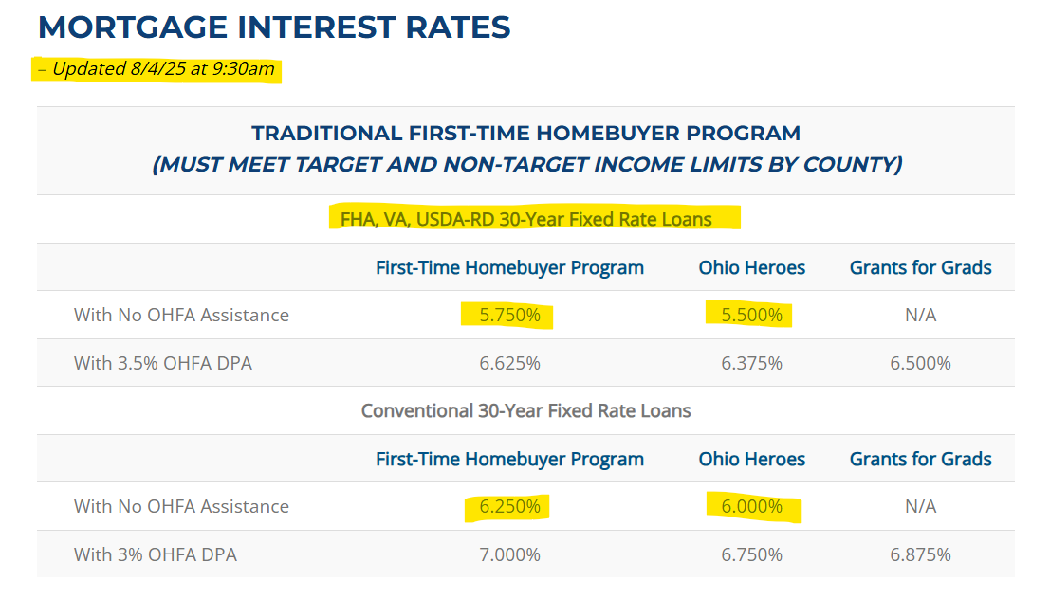
Ohio Heroes Interest Rate Example
5.5%
6%
For informational purposes only

Slide 114


Grants for Grads
Borrowers must have graduated college within the last 18 months with an associate’s, bachelor’s, master’s or doctorate degree.
If the buyer stays within Ohio for the first 5 years, they don’t have to pay back the down payment assistance, even if they sell or refinance the property.

Slide 115
OHFA Grants for Grads Assistance Offered
Conventional
3%
FHA, VA, USDA
3.5%

Slide 116
Grants for Grads Repayment Requirements
Only if Moving Out of Ohio
Time Resided in Home | Amount of Grant Owed to OHFA
Less than 1 year | 100%
1 year to 2 years | 80%
2 years to 3 years | 60%
3 years to 4 years | 40%
4 years to 5 years | 20%
5 years or more | 0%

Slide 117
FHA Loan (3.5% DP Requirement)
Purchase Price $200,000
3.5% Grants for Grads Assistance $7,000
Subtract the Down Payment and Closing Costs
3.5% Down Payment -$7,000
________________________________________________
Approximate out-of-pocket funds: $4,000-$6,000
This is based on approximate closing costs of $6,000. Closing costs vary for each lender.
Seller can contribute money towards buyers closing costs.

Slide 118


Slide 119


Mortgage Tax Credit Program
The intent of the tax credit is to help first-time homebuyers afford homeownership.
Must request the tax credit when applying for your mortgage loan.

Slide 120
Mortgage Tax Credit Program Example
$200,000 Home Purchase
Loan Amount | $194,000
Loan Term | 30 Years
Interest Rate | 7%
Mortgage Credit Rate | 20%
For informational purposes only

Slide 121
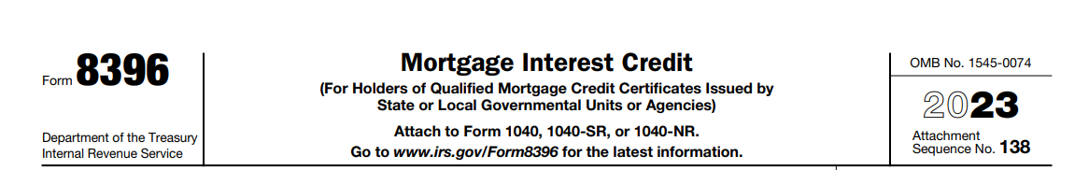
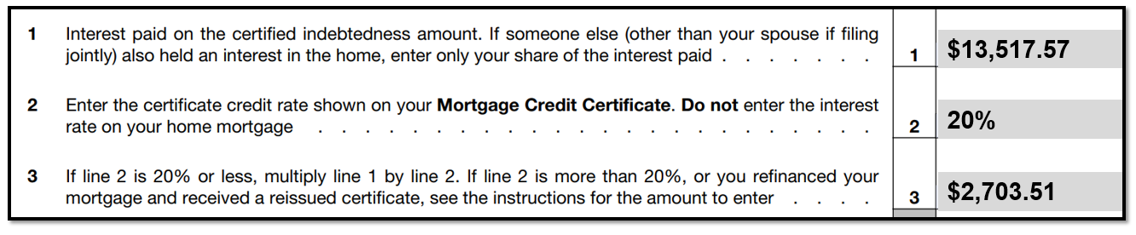
Mortgage Tax Credit Program Example
For informational purposes only

Slide 122
Mortgage Tax Credit Program Example
Year | Interest | Principal | Ending Balance | Tax Credit Savings
1 | $13,517.57 | $1,970.67 | $192,029.33 | $2,703.51
2 | $13,375.11 | $2,113.13 | $189,916.20 | $2,675.02
3 | $13,222.35 | $2,265.89 | $187,650.31 | $2,644.47
4 | $13,058.55 | $2,429.69 | $185,220.62 | $2,611.71
5 | $12,882.91 | $2,605.33 | $182,615.28 | $2,576.58
6 | $12,694.57 | $2,793.67 | $179,821.61 | $2,538.91
7 | $12,492.61 | $2,995.63 | $176,825.98 | $2,498.52
8 | $12,276.06 | $3,212.18 | $173,613.80 | $2,455.21
9 | $12,043.85 | $3,444.39 | $170,169.41 | $2,408.77
10 | $11,794.80 | $3,693.39 | $166,476.02 | $2,358.96
 |  |  |  | $25,471.68
According to the National Association of Realtors, 10 years is the average time a homebuyer stays in their home.
For informational purposes only

Slide 123
Mortgage Tax Credit Program Example
Homebuyer made $70,000 in income. The homebuyer owes approximately $6,000 in federal income taxes.
Their mortgage tax credit (first year) is $2,703.51.
Total federal income taxes now due are $3,296.49.
If the homebuyer claimed the credit for the first 10 years on their mortgage, that could be a savings of $25,471.68 in federal income taxes!

Slide 124

Mortgage Tax Credit Program-Continued
Two options for claiming the credit:
End of the year tax credit.
Adjust your withholding to pay less taxes throughout the year.

Slide 125
Mortgage Tax Credit Program-Credit Rates
MTC Basic (Can be used with any loan including non-OHFA loans. The lender still needs to be an OHFA-approved lender.)
Non-target areas = 15%
Target areas = 20%
MTC Plus* (Can combine with multiple programs and products and receive maximum 40% tax benefit under the MTC program.)
OHFA Loans = 40%
*There could be an interest rate increase for the mortgage tax credit plus program.

Slide 126


Next Home
Next Home is available for Ohio homebuyers who are not first-time homebuyers.
Homebuyers can receive down payment assistance.
Most of the eligibility requirements are the same as the first-time homebuyer program.

Slide 127
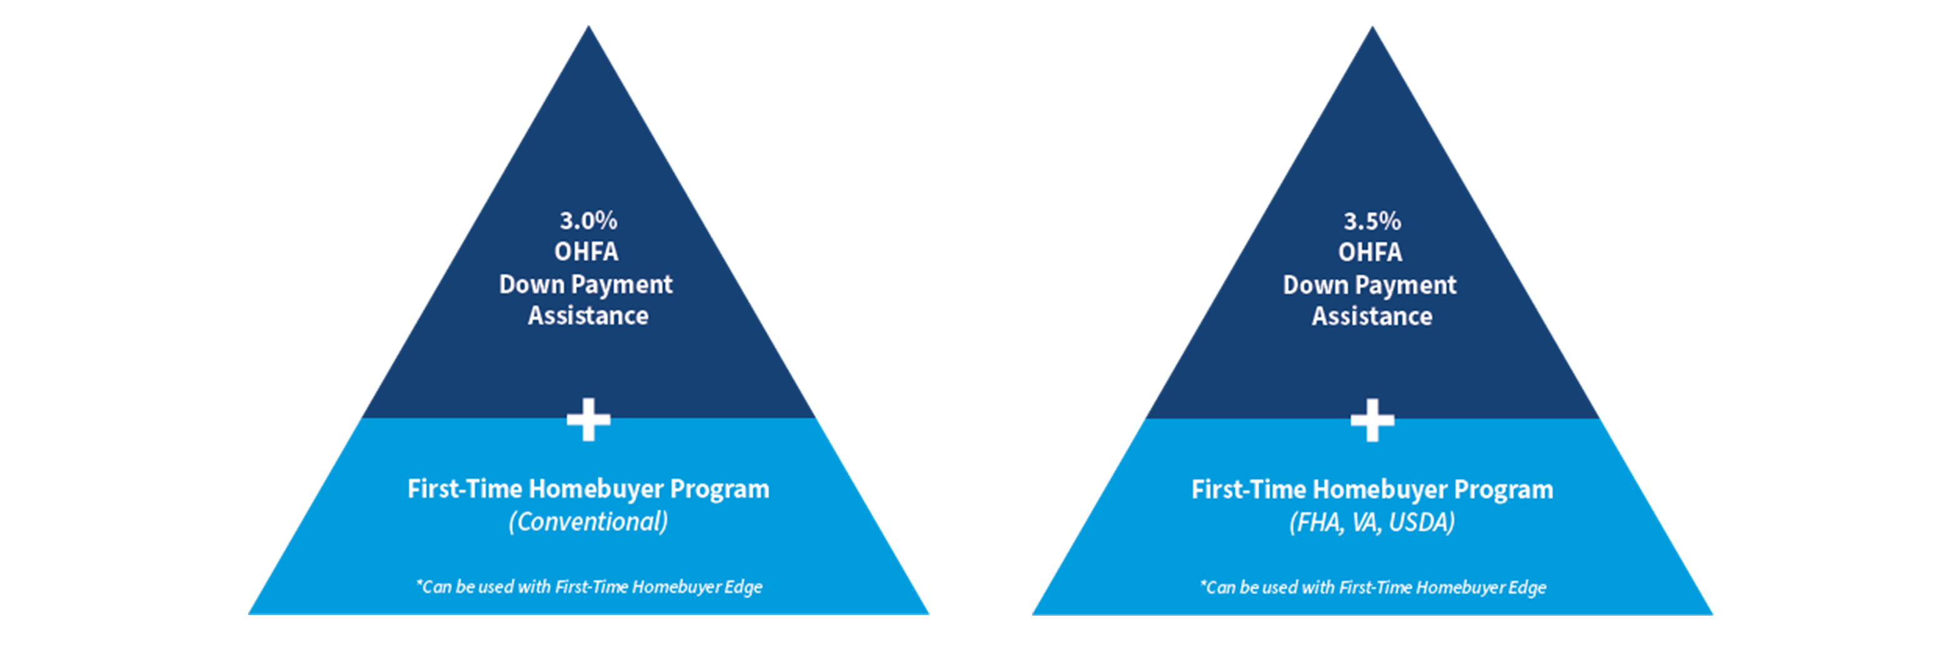
OHFA Combinations

Slide 128
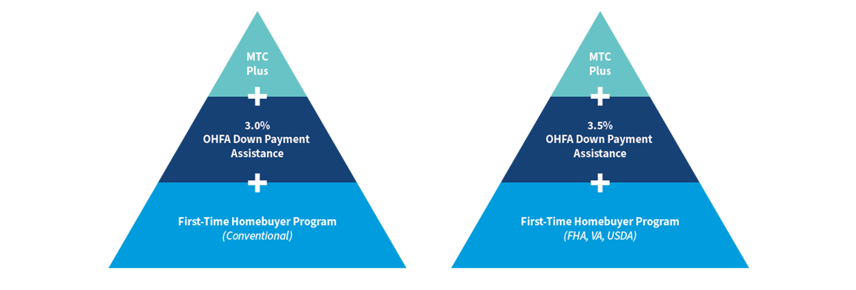
OHFA Combinations

Slide 129
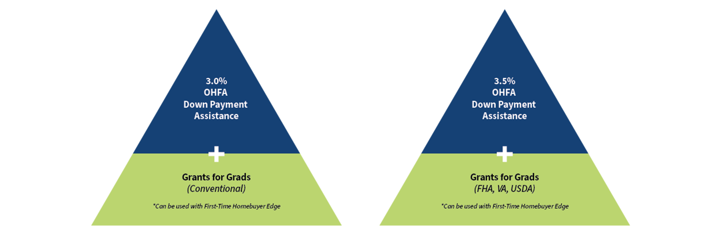
OHFA Combinations

Slide 130
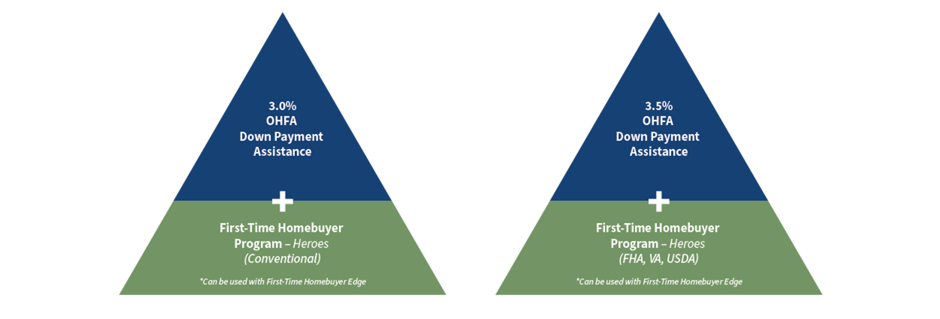
OHFA Combinations

Slide 131
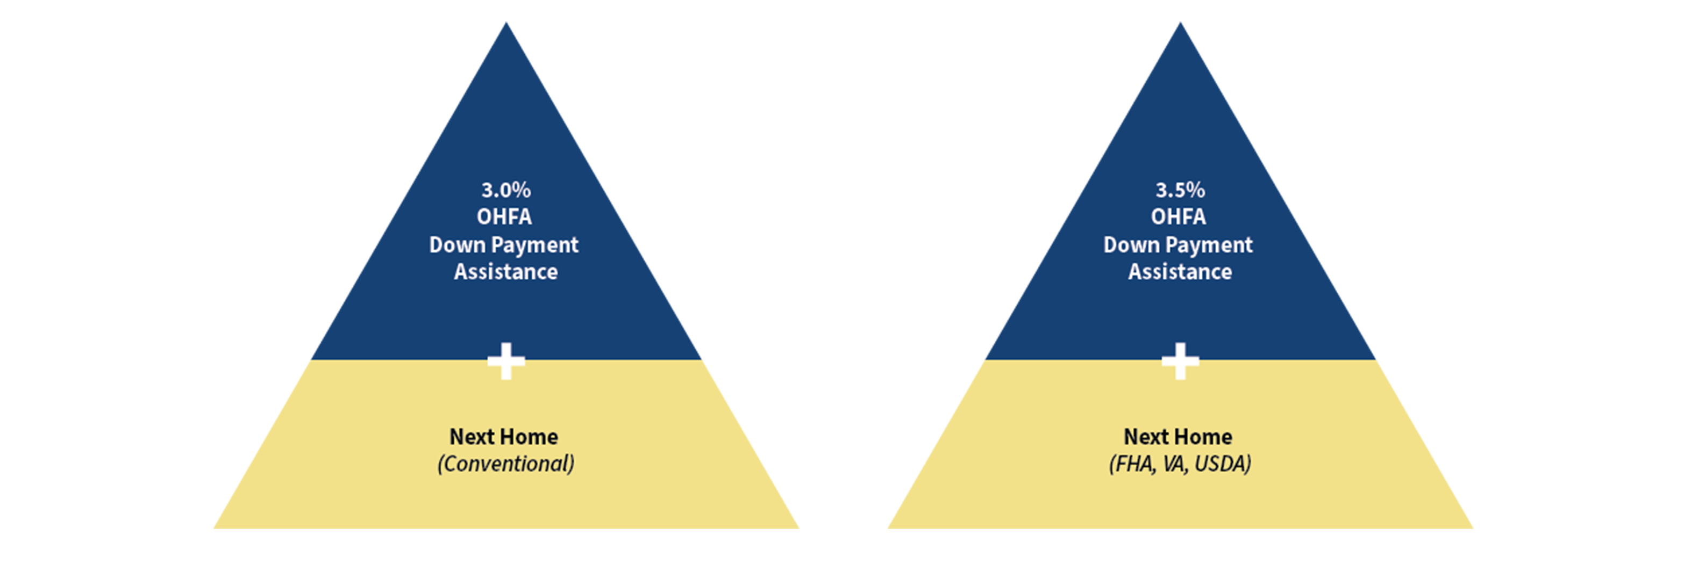
OHFA Combinations

Slide 132

We recommend that you direct your clients to our consumer facing website:
Myohiohome.org

Slide 133
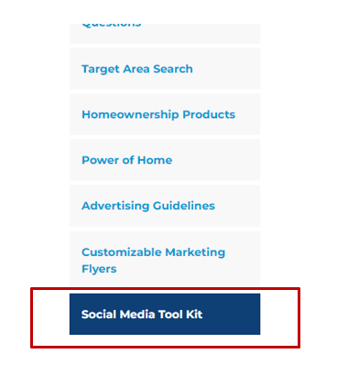
Social Media Toolkit
Visit ohiohome.org and click on "Our Partners" and then "Real Estate Agents."

Slide 134


Slide 135

Your certificates will be emailed by Tuesday.

Slide 136
All information in this presentation, brochure, or term sheet is for informational purposes only. OHFA Homeownership Programs and Products are subject to change. Additional eligibility requirements may be required based on borrower specific criteria.

